Slide 1
Predicting Corporate Credit Rating
Kamila Makhambetova
February 2025

Slide 2
Agenda
Executive Summary
Pre-processing: Exploratory Data Analysis
Modelling
Results
Enhancements

Slide 3
Executive Summary
Goal
To develop a classification model to predict credit ratings/risk levels of US companies based on a set of financial indicators.
Output:
The top 3 highest performing models for assessing risk level/credit rating after parameter tuning and feature selection are KNN, RF, GB.
Oversampling significantly improved Macro Average F1 Score of models
Top 3 models (on TEST SAMPLE) | Macro Average F1 Score for Rating (imbalanced) | Macro Average F1 Score for Rating (oversampling) | Macro Average F1 Score for Risk level (imbalanced) | Macro Average F1 Score for Risk level (oversampling)
KNN | 0.52 | 0.81 | 0.55 | 0.77
Random Forest | 0.49 | 0.78 | 0.59 | 0.73
Gradient Boosting | 0.46 | 0.76 | 0.53 | 0.75

Slide 4
Dataset
Dependent Variable | Independent Variables / Predictors
Rating | Liquidity Measurement Ratios (4) | Profitability Indicator Ratios (9) | Debt Ratios (3) | Operating Performance Ratios (3) | Cash Flow Indicator Ratios (5) | Valuation Ratios (1) | Other Variables (5)
 | Current Ratio | Gross Profit Margin | Debt Ratio | Asset Turnover | Operating Cash Flow Per Share | Enterprise Value Multiple | Name
 | Quick Ratio | Operating Profit Margin | Debt Equity Ratio | Fixed Asset Turnover | Free Cash Flow Per Share |  | Symbol (for trading)
 | Cash Ratio | Pretax Profit Margin | Company Equity Multiplier | Payables Turnover | Cash Per Share |  | Agency Name
 | Days Of Sales Outstanding | Net Profit Margin |  |  | Operating Cash Flow Sales Ratio |  | Date
 |  | Effective Tax Rate |  |  | Free Cash Flow Operating Cash Flow Ratio |  | Sector
 |  | Return On Assets
 |  | Return On Equity
 |  | Return On Capital Employed
 |  | Ebit Per Revenue
Credit ratings of US large corporations (traded on NYSE or Nasdaq) issued by major agencies
Number of observations: 2029
Time Period: 2005-2016
Source: https://www.kaggle.com/datasets/agewerc/corporate-credit-rating/data

Slide 5
MODEL DEVELOPMENT PROCESS
Preprocessing/EDA
Modelling
Assessment of Results
Feature Selection/Model Fitting
Parameter Tuning
Oversampling
Missing Values/Outliers
Logistic Regression
Transformations
KNN
Collinearity
Best Model
LDA
Grid Search
SMOTE
Enhancements
Gradient Boosting
Random Forest

Slide 6
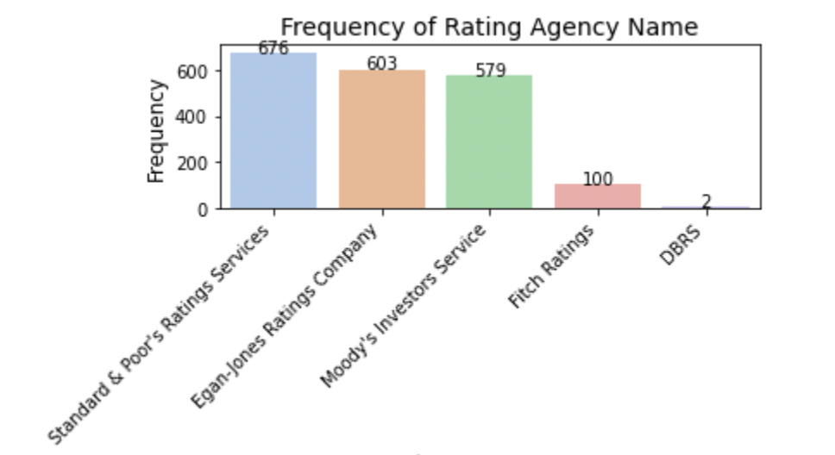
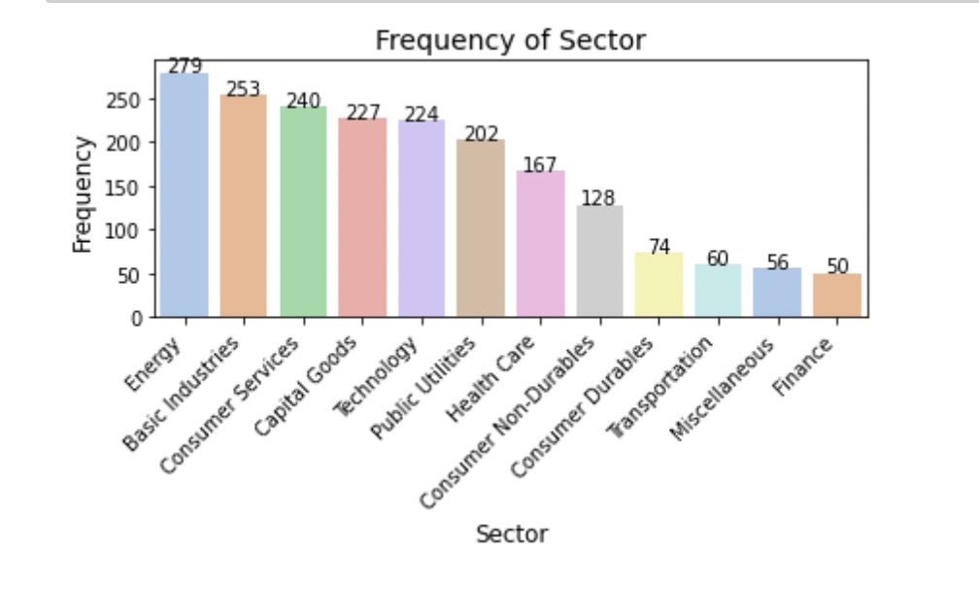
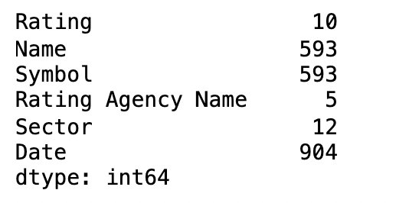
Exploratory DATA Analysis (Sector, Agency name AND Company name)
593 US companies
5 Rating Agencies: Standard & Poor’s, Egan-Jones, Moody’s, Fitch, DBRS
12 Sectors: Energy (most common), …, Finance (least common)

Slide 7
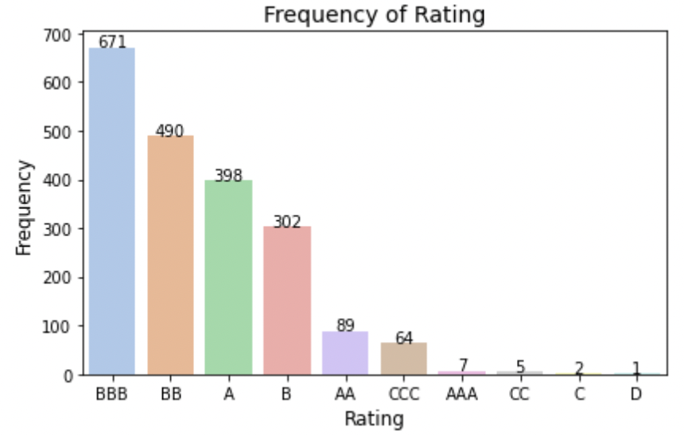
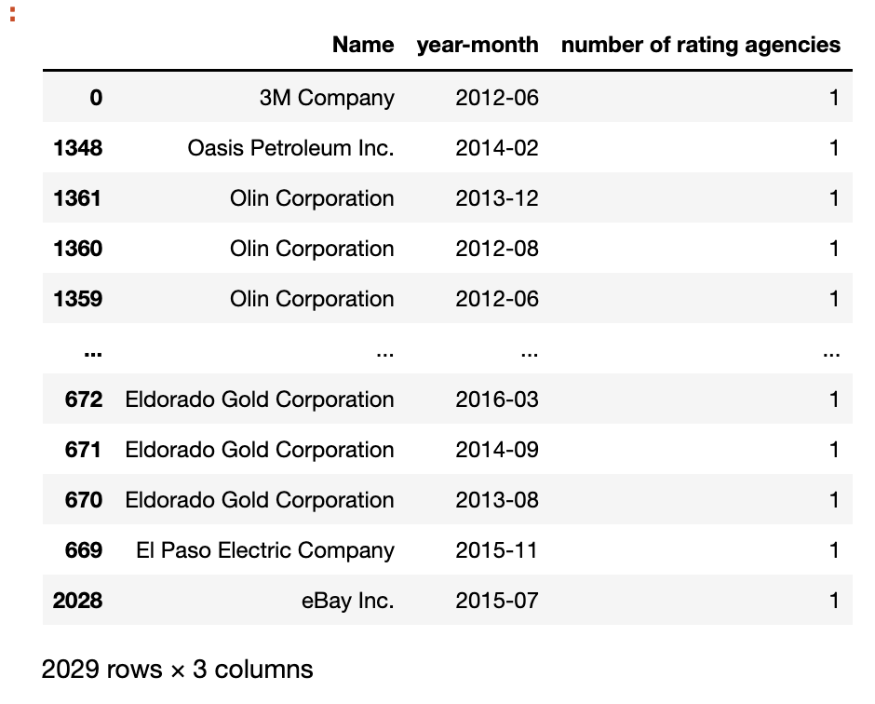
Exploratory DATA Analysis (Rating)
10 Credit Rating types: AAA, AA, A, BBB, BB, B, CCC, CC, C, D.
Every company in the dataset was rated by one rating agency per specific date.

Slide 8
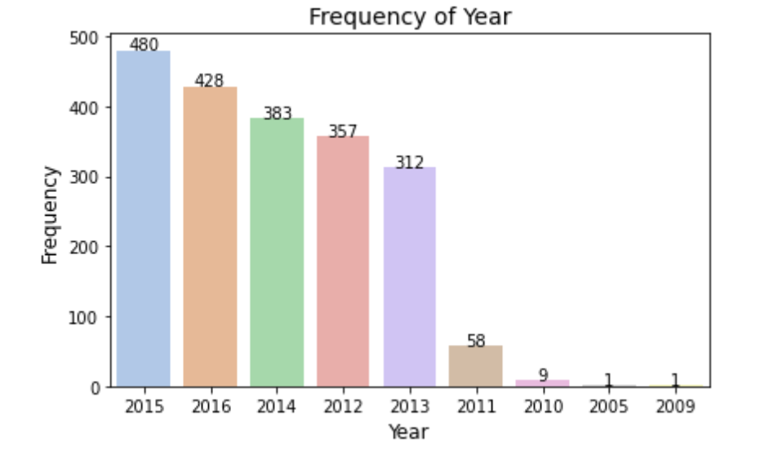
Exploratory DATA Analysis (date)

Slide 9
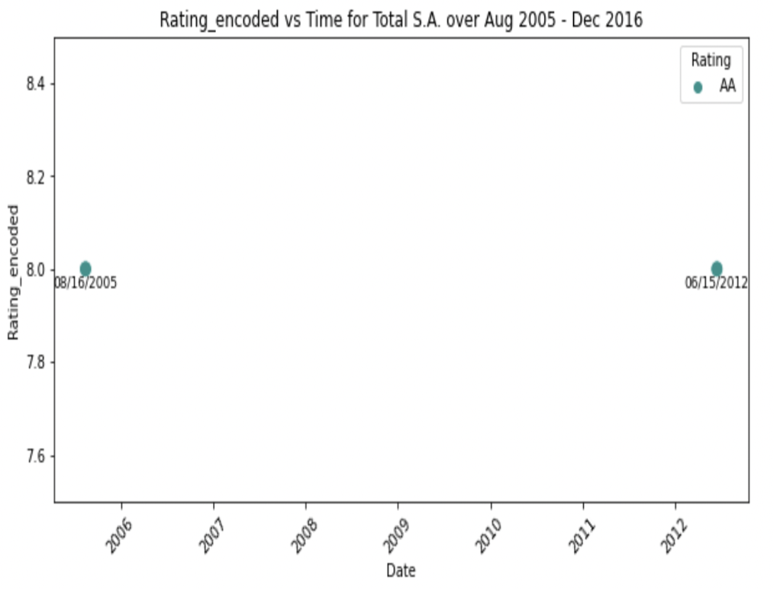
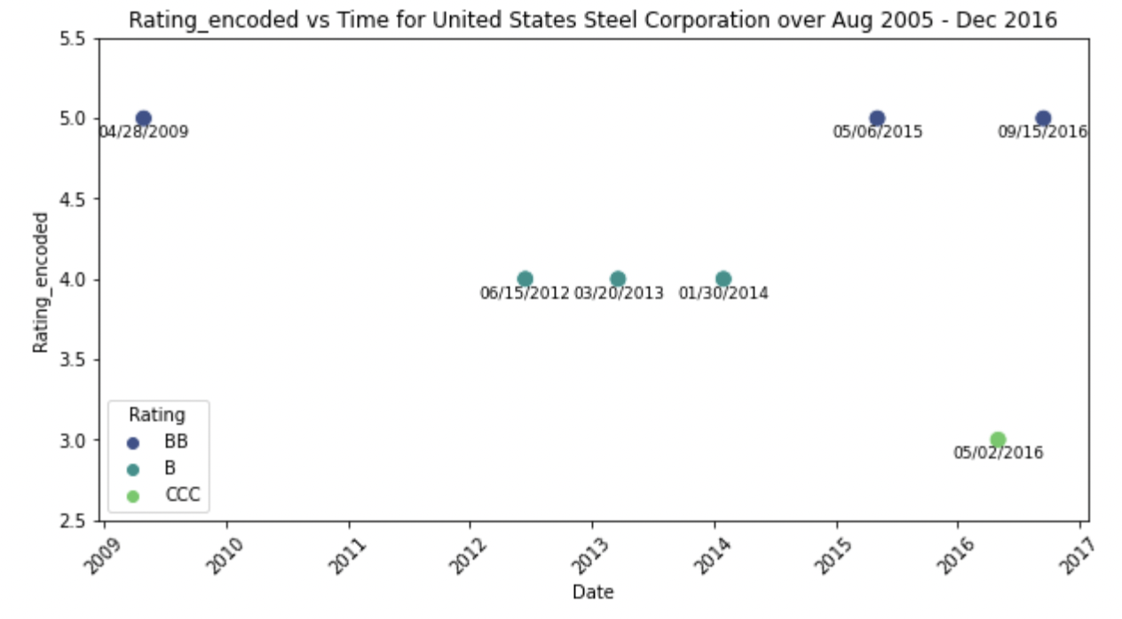
Exploratory DATA Analysis (time dependency)

Slide 10
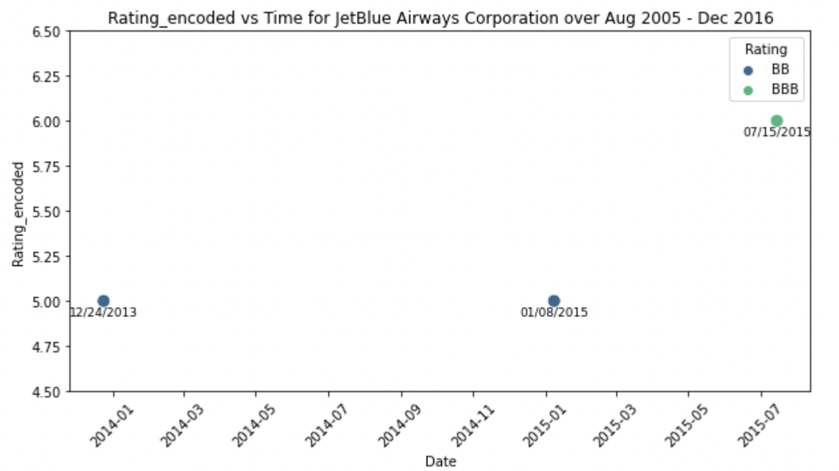
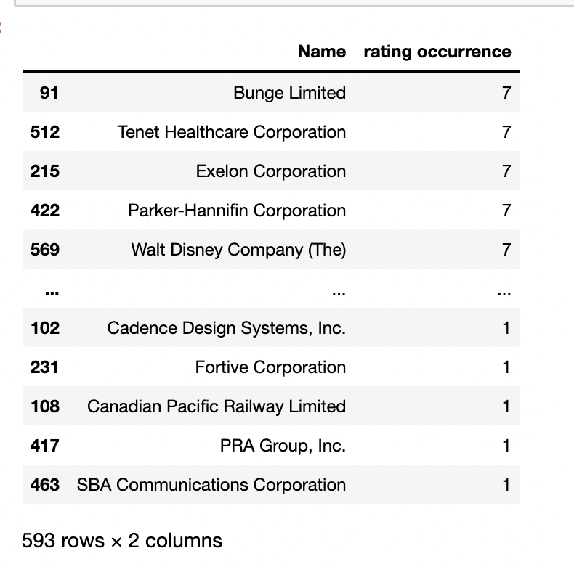
Exploratory DATA Analysis (time dependency)
Average Rating Occurrence during 2005 - 2016 period : 3.42
Not enough data for proper time series analysis

Slide 11
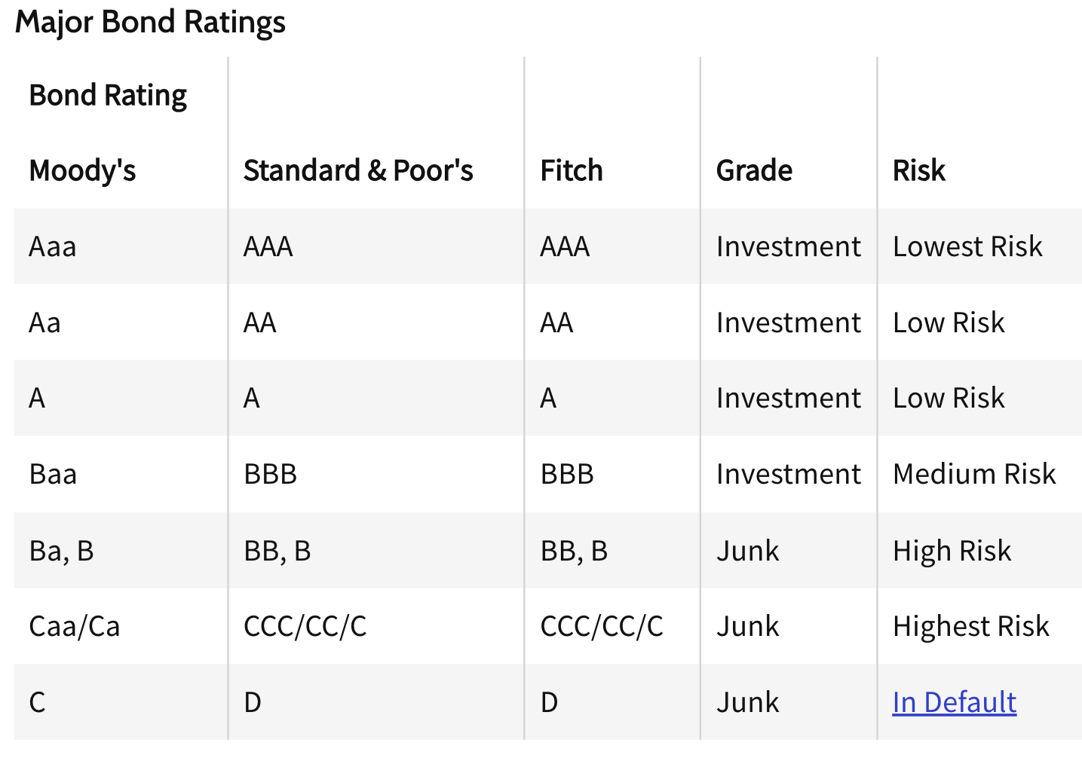
Exploratory DATA Analysis (Encoding)
Create new column Risk_level
Encode Risk_level and Rating columns and create new columns Risk_level_encoding and Rating_encoding
Risk level | Risk level encoded
Lowest Risk | 0
Low Risk | 1
Medium Risk | 2
High Risk | 3
Highest Risk | 4
In Default | 5
Rating | Rating encoded
AAA | 9
AA | 8
A | 7
BBB | 6
BB | 5
B | 4
CCC | 3
CC | 2
C | 1
D | 0
Source: https://www.investopedia.com/terms/c/corporate-credit-rating.asp

Slide 12
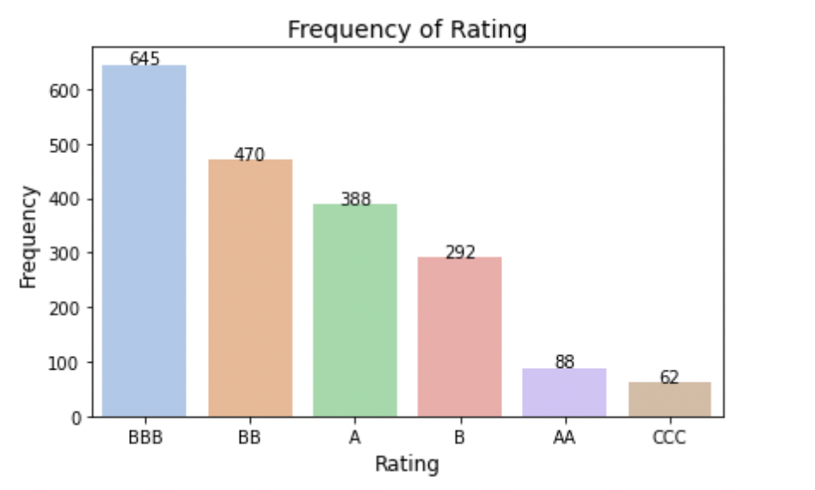
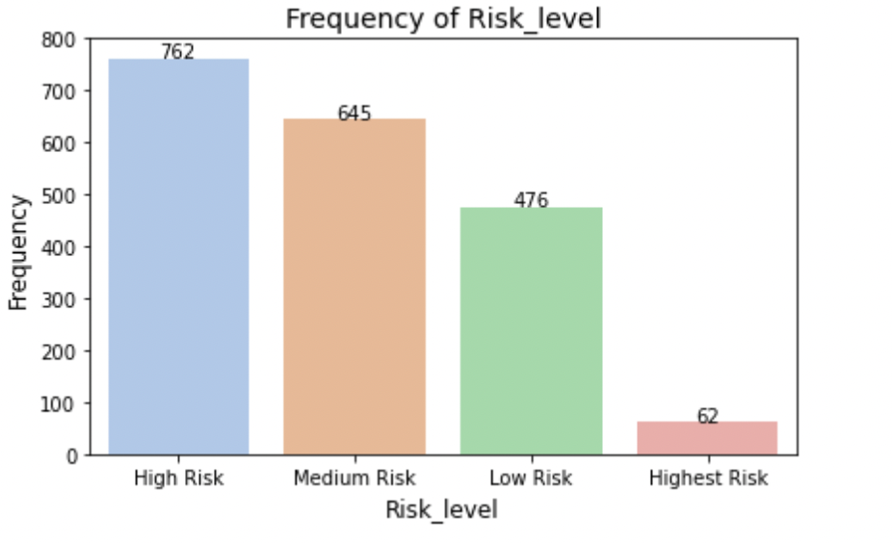
Exploratory DATA Analysis (Conclusion)

Slide 13
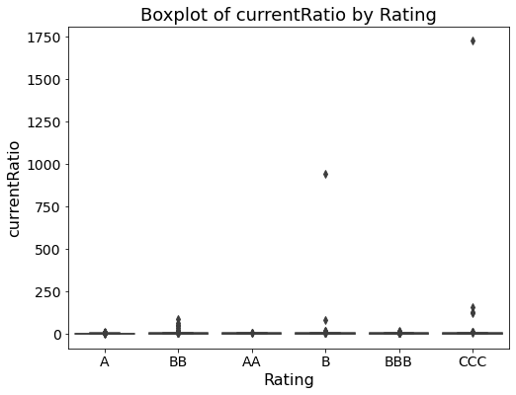
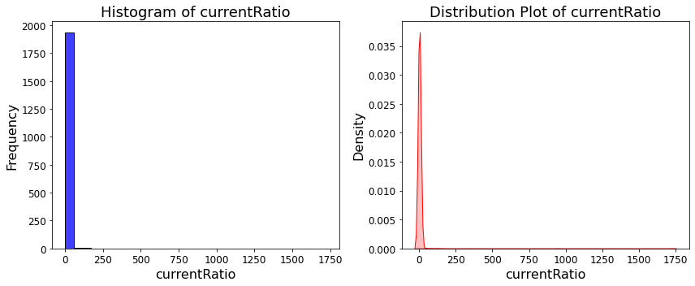
Distribution of 25 financial indicators and outlier analysis
The boxplot and distribution graphs were drawn for each financial indicator. Skewness was examined. Absolute skewness between 0 and 1 indicates normality.

Slide 14
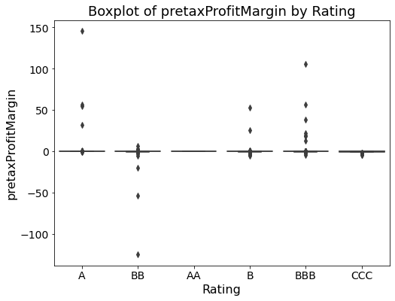
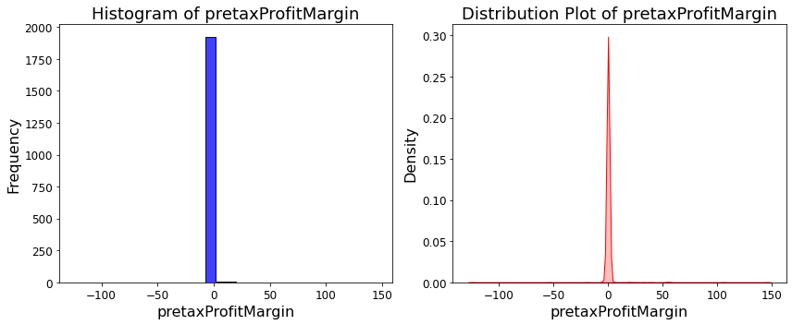
Distribution of 25 financial indicators and outlier analysis
To see graphs for other predictors, please see my Jupiter Notebook.

Slide 15
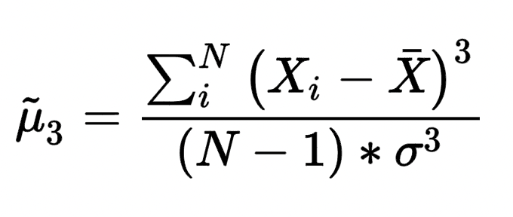
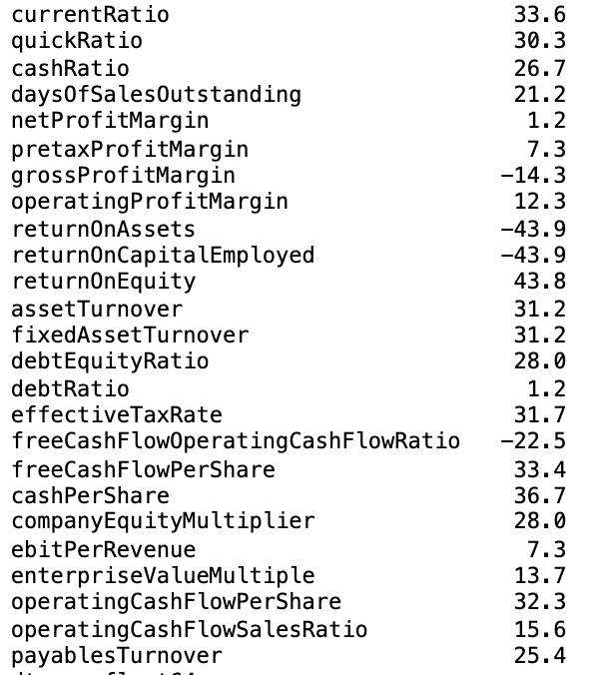
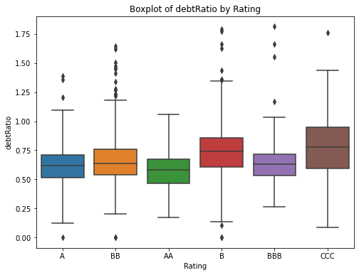
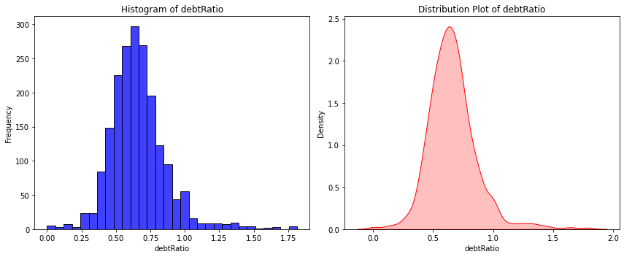
Distribution of 25 financial indicators and outlier analysis
Skewness of Predictors
Most of predictors (23/25) are extremely skewed. Only netProfit Margin and debtRatio are normally distributed.

Slide 16
Distribution of 25 financial indicators and outlier analysis
IQR Method
IQR = Q₃ – Q₁
Lower bound = Q₁ – 1.5*IQR
Upper bound = Q₃ + 1.5*IQR
value < lower bound or value > upper bound → an outlier
Predictors | Num Outliers | Percentage Outliers
returnOnEquity | 302 | 15.53
debtEquityRatio | 267 | 13.73
companyEquityMultiplier | 266 | 13.68
effectiveTaxRate | 235 | 12.08
netProfitMargin | 231 | 11.88
pretaxProfitMargin | 228 | 11.72
enterpriseValueMultiple | 220 | 11.31
ebitPerRevenue | 219 | 11.26
cashPerShare | 197 | 10.13
freeCashFlowPerShare | 186 | 9.56
operatingProfitMargin | 185 | 9.51
returnOnAssets | 164 | 8.43
quickRatio | 163 | 8.38
operatingCashFlowPerShare | 157 | 8.07
operatingCashFlowSalesRatio | 156 | 8.02
fixedAssetTurnover | 144 | 7.4
returnOnCapitalEmployed | 143 | 7.35
cashRatio | 135 | 6.94
currentRatio | 126 | 6.48
freeCashFlowOperatingCashFlowRatio | 116 | 5.96
payablesTurnover | 113 | 5.81
assetTurnover | 104 | 5.35
daysOfSalesOutstanding | 80 | 4.11
debtRatio | 78 | 4.01
grossProfitMargin | 10 | 0.51

Slide 17
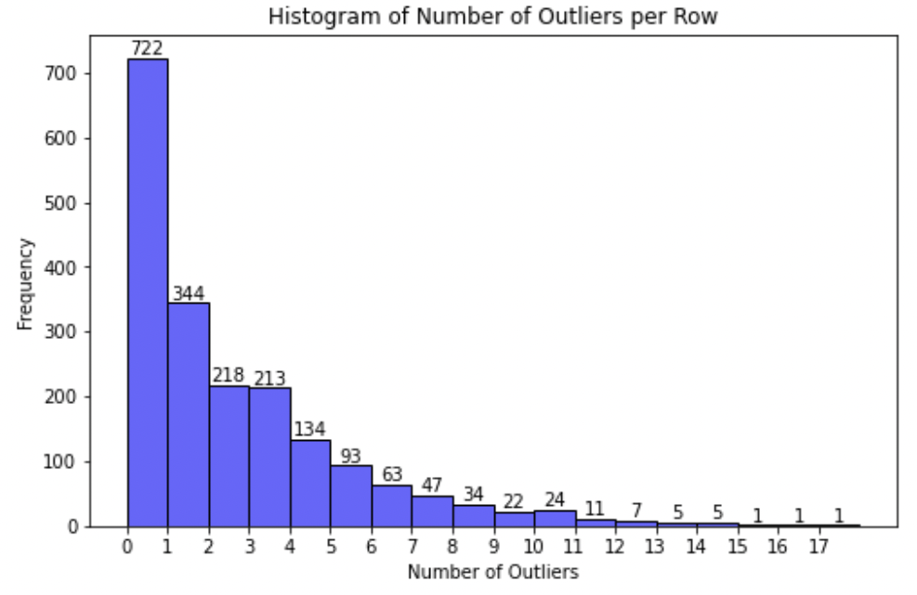
Distribution of 25 financial indicators and outlier analysis
Only 722/1945 observations have 0 outliers.
Decision: substitute outliers by lower or upper bounds.
Outlier > upper → outlier = upper
Outlier < lower → outlier = lower

Slide 18
Distribution of 25 financial indicators and outlier analysis
Predictors | Skewness (original dataset) | Skewness (after outliers substitution)
currentRatio | 33.6 | 0.9
quickRatio | 30.3 | 0.8
cashRatio | 26.7 | 1.1
daysOfSalesOutstanding | 21.2 | 0.5
netProfitMargin | 1.2 | 0.1
pretaxProfitMargin | 7.3 | 0.1
grossProfitMargin | -14.3 | 0.3
operatingProfitMargin | 12.3 | 0.1
returnOnAssets | -43.9 | 0
returnOnCapitalEmployed | -43.9 | 0.1
returnOnEquity | 43.8 | 0
assetTurnover | 31.2 | 1
fixedAssetTurnover | 31.2 | 1.2
debtEquityRatio | 28 | 0.4
debtRatio | 1.2 | 0.3
effectiveTaxRate | 31.7 | -0.3
freeCashFlowOperatingCashFlowRatio | -22.5 | -0.7
freeCashFlowPerShare | 33.4 | 0.3
cashPerShare | 36.7 | 1.1
companyEquityMultiplier | 28 | 0.4
ebitPerRevenue | 7.3 | 0.1
enterpriseValueMultiple | 13.7 | 0.2
operatingCashFlowPerShare | 32.3 | 0.7
operatingCashFlowSalesRatio | 15.6 | 0.8
payablesTurnover | 25.4 | 0.8
After the substitution of outliers absolute skewness for each financial indicator ranged between 0 and 1.

Slide 19
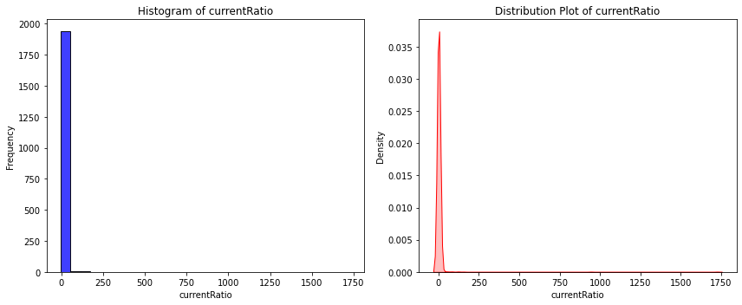
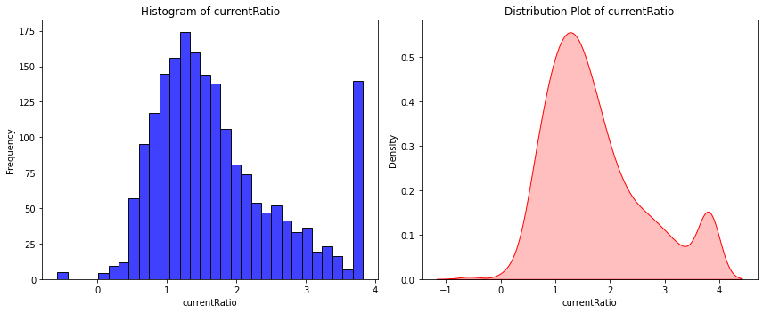
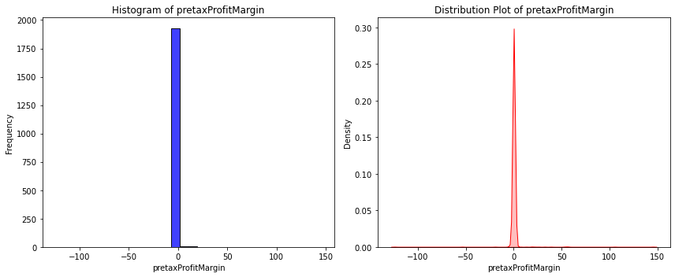
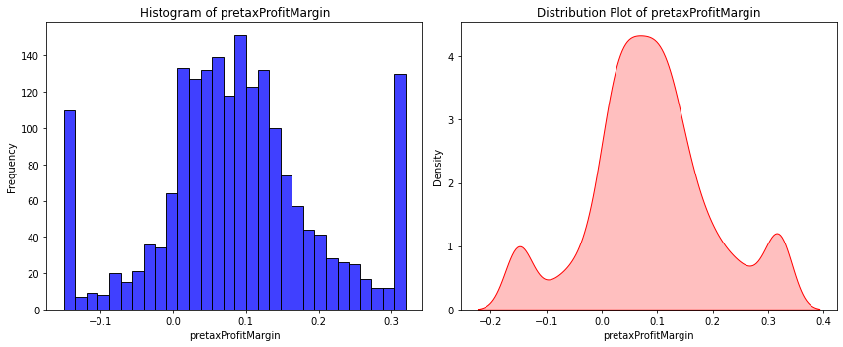
Distribution of 25 financial indicators and outlier analysis
The distribution of each predictor is significantly improved after outlier substitution.
Predictors are approximately normally distributed.

Slide 20
Proper Metric and ML algorithms
Set of predictors: 25 financial indicators + Sector
Target/Response variable: Risk level / Credit Rating
ML classification algorithms: Random Forest, Gradient Boosting, KNN, Logistic Regression, Linear Discriminant Analysis (Appendix 1 – 5)
80% Train dataset, 20% Test dataset
For KNN, the function finds the best k (number of neighbors)
Problem: Imbalanced dataset

Slide 21
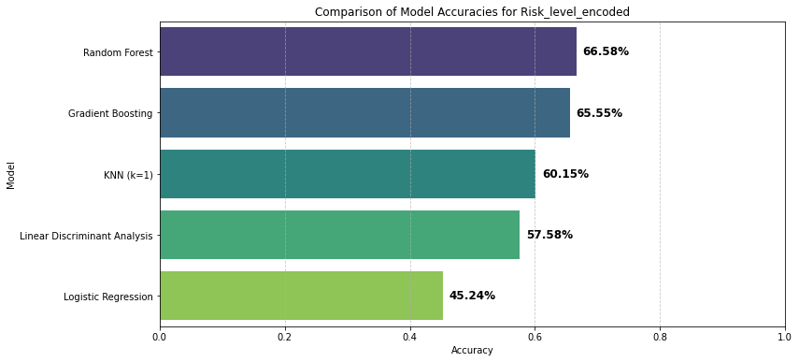
Proper Metric and ML algorithms Accuracy -> Not relevant

Slide 22
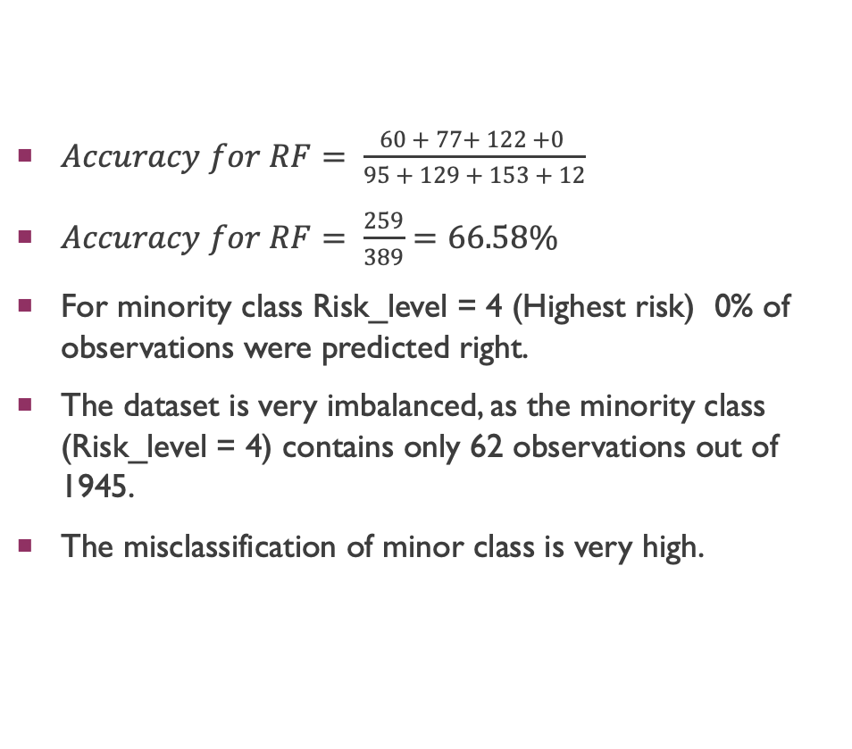
Proper Metric and ML algorithms Accuracy -> not relevant
$Accuracy for RF= \frac{60 + 77+ 122 +0 }{95 + 129 + 153 + 12}$
$Accuracy for RF= \frac{259}{389}=66.58\%$
For minority class Risk_level = 4 (Highest risk) 0% of observations were predicted right.
The dataset is very imbalanced, as the minority class (Risk_level = 4) contains only 62 observations out of 1945.
The misclassification of minor class is very high.
Confusion Matrix for RF on Test Dataset
Actual Risk | Predicted Risk
 | Category | 1 | 2 | 3 | 4 | Predicted Correctly
 | 1 (Low) | 60 | 26 | 9 | 0 | 60/95 = 63.16%
 | 2 (Medium) | 17 | 77 | 35 | 0 | 77/129 = 59.69%
 | 3 (High) | 6 | 24 | 122 | 1 | 122/153 = 79.74 %
 | 4 (Highest) | 0 | 1 | 11 | 0 | 0/12 = 0%

Slide 23
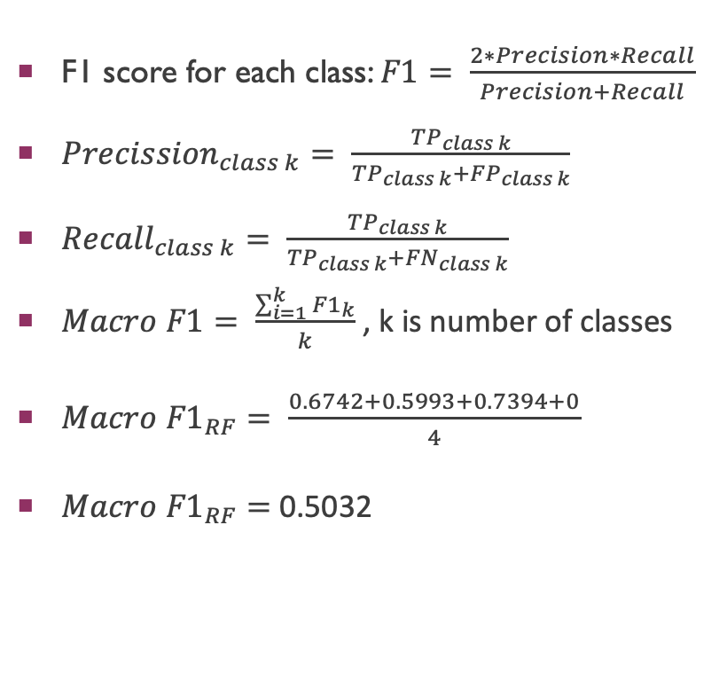
Proper Metric and ML algorithms Macro F1 SCORE
F1 score for each class: $F1= \frac{2∗Precision∗Recall}{Precision+Recall}$
${Precission}_{class k}= \frac{{TP}_{class k}}{{TP}_{class k}+{FP}_{class k}}$
${Recall}_{class k}= \frac{{TP}_{class k}}{{TP}_{class k}+{FN}_{class k}}$
$Macro F1= \frac{\sum_{i=1}^{k}{{F1}_{k}}}{k}$ , k is number of classes
$Macro {F1}_{RF}= \frac{0.6742+0.5993+0.7394+0}{4}$
$Macro {F1}_{RF}=$ 0.5032
Confusion Matrix for RF on Test Dataset
Actual Risk | Predicted Risk
 | Category | 1 | 2 | 3 | 4 | Precision for each class | Recall for each class | F1 for each class
 | 1 | 60 | 26 | 9 | 0 | 60/83 = 72.29% | 60/95 = 63.16% | 67.42%
 | 2 | 17 | 77 | 35 | 0 | 77/128 = 60.16% | 77/129 = 59.69% | 59.92%
 | 3 | 6 | 24 | 122 | 1 | 122/177 = 68.93 % | 122/153 = 79.74% | 73.94%
 | 4 | 0 | 1 | 11 | 0 | 0/1 = 0% | 0/12 = 0% | 0%

Slide 24
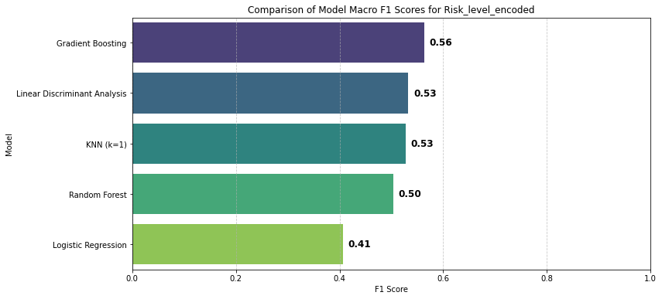
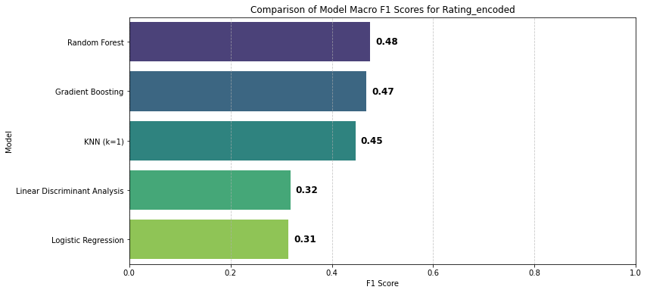
Proper Metric and ML algorithms Macro F1 SCORE
The F1 Score measures how well the model balances between correctly identifying class (precision) and catching all observations that belong to this class (recall).
FP and FN are equally costly.
Correctly classifying every class is key.

Slide 25
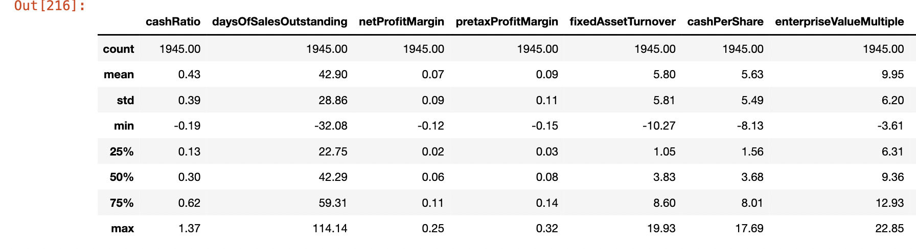
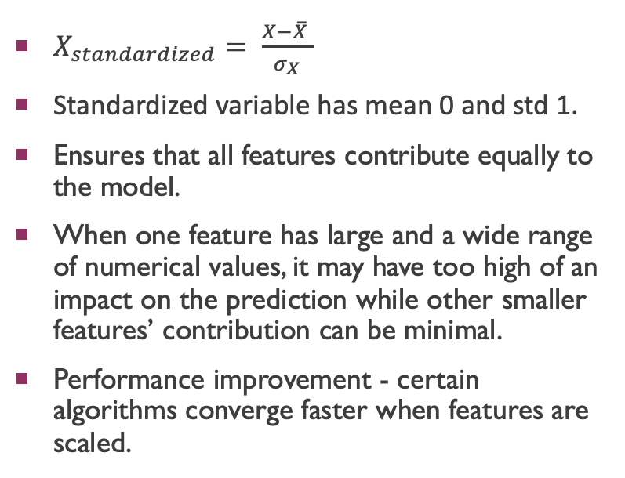
Standardization of predictors
$X_{standardized}= \frac{X−\overline{X} }{σ_{X}}$
Standardized variable has mean 0 and std 1.
Ensures that all features contribute equally to the model.
When one feature has large and a wide range of numerical values, it may have too high of an impact on the prediction while other smaller features’ contribution can be minimal.
Performance improvement - certain algorithms converge faster when features are scaled.
Statistical Summary for Selected Predictors
Some variables such as daysofSalesOutstanding, fixedAssetTurnover, cashPerShare, enterpriseValueMultiple differ significantly in their range from other financial indicators.

Slide 26
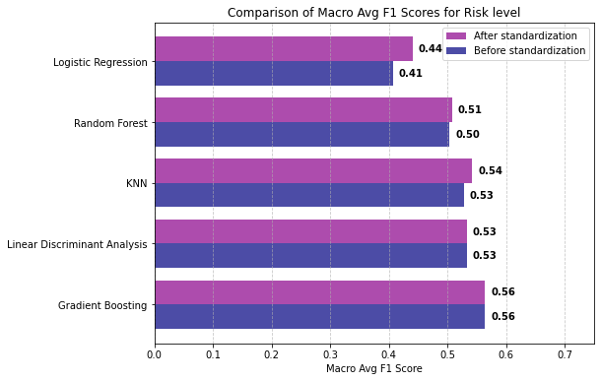
Standardization of predictors
LR (Macro F1 +0.03)
RF (Macro F1 +0.01)
KNN (Macro F1 +0.01)

Slide 27
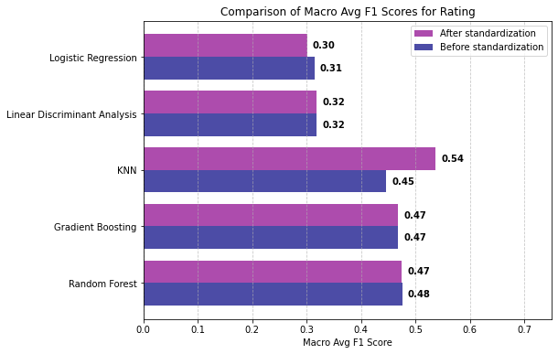
Standardization of predictors
LR (Macro F1 -0.01)
KNN (Macro F1 +0.09)
RF (Macro F1 -0.01)

Slide 28
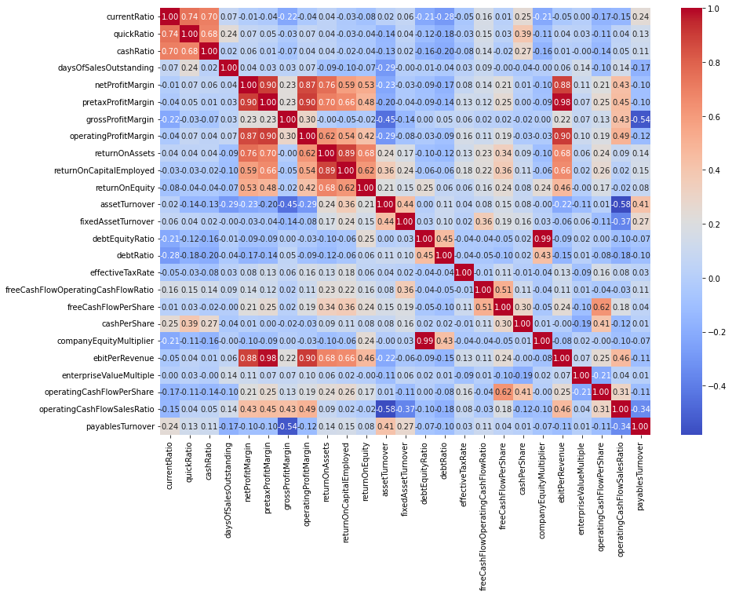
Multicollinearity
Pearson’s correlation coefficient
Some set of predictors have a correlation coefficient > 0.9
ebitPerRevenue & preTaxProfitMargin = 0.98
debtEquityRatio & companyEquityMultiplier = 0.99

Slide 29
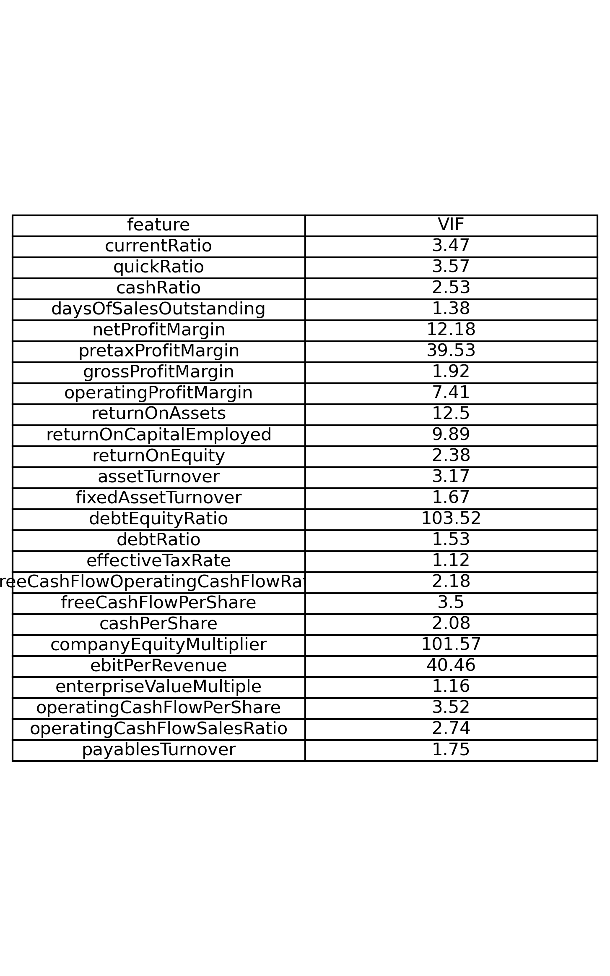
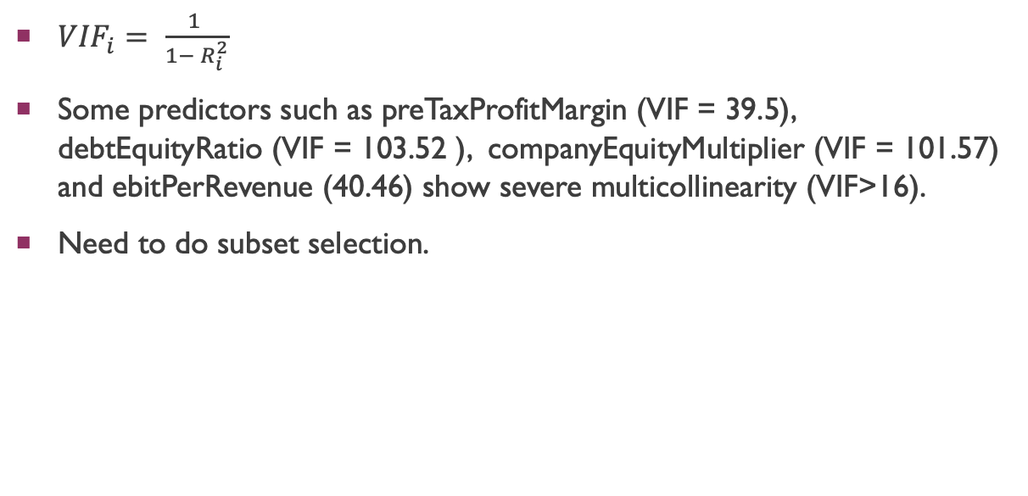
Multicollinearity
${VIF}_{i}= \frac{1 }{1− R_{i}^{2}}$
Some predictors such as preTaxProfitMargin (VIF = 39.5), debtEquityRatio (VIF = 103.52 ), companyEquityMultiplier (VIF = 101.57) and ebitPerRevenue (40.46) show severe multicollinearity (VIF>16).
Need to do subset selection.

Slide 30
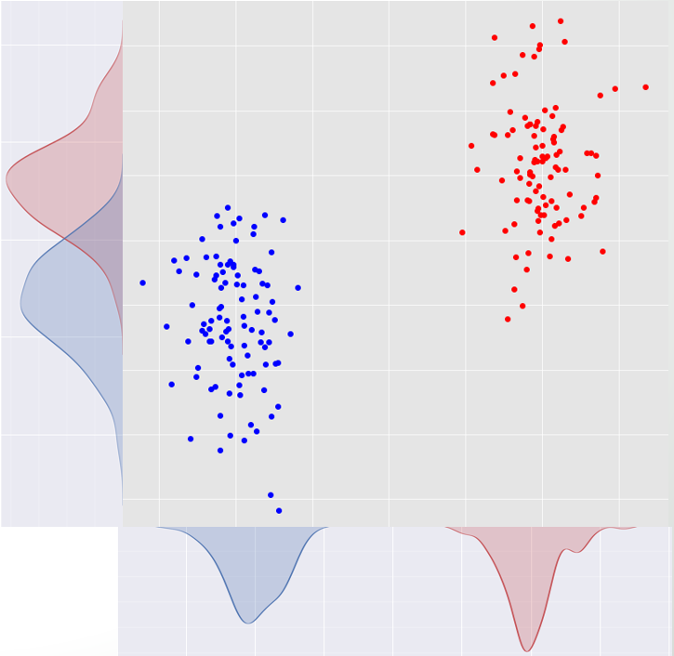
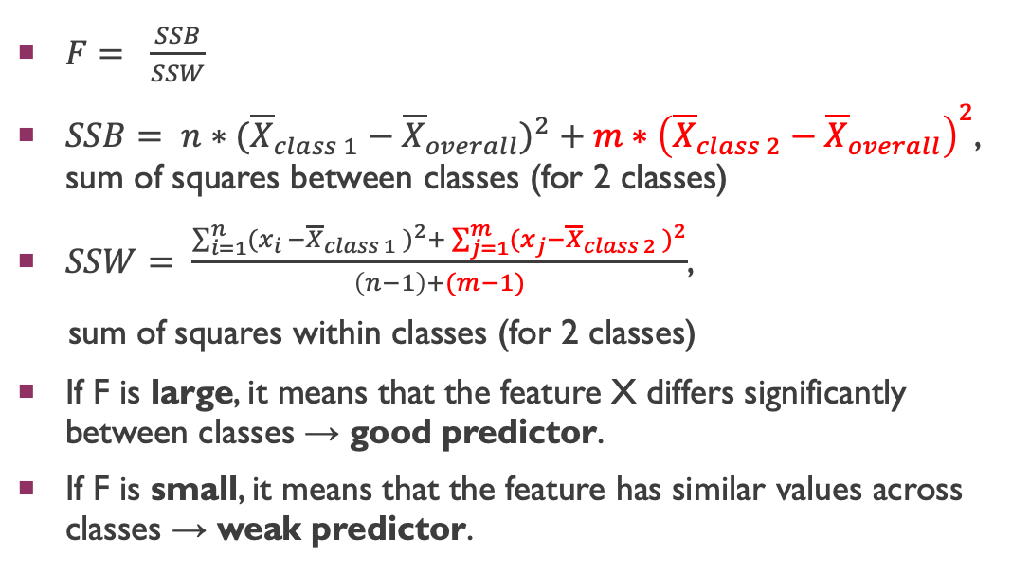
Feature Selection (ANOVA F test)
$F= \frac{SSB}{SSW}$
$SSB= {n∗({\overline{X}}_{class 1}−{\overline{X}}_{overall})}^{2}+m∗{\left({\overline{X}}_{class 2}−{\overline{X}}_{overall}\right)}^{2}$, sum of squares between classes (for 2 classes)
$SSW= \frac{\sum_{i=1}^{n}{{(x_{i }−{\overline{X}}_{class 1} )}^{2}+\sum_{j=1}^{m}{{(x_{j}−{\overline{X}}_{class 2} )}^{2}}}}{\left(n−1\right)+(m−1)}$,
sum of squares within classes (for 2 classes)
If F is large, it means that the feature X differs significantly between classes → good predictor.
If F is small, it means that the feature has similar values across classes → weak predictor.
X₁ – bad predictor, low F score
X₂ – good predictor,
high F score

Slide 31
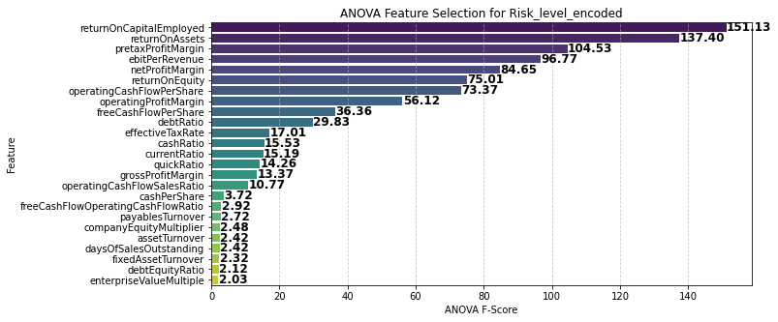
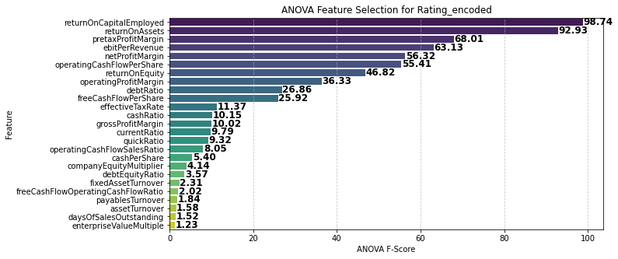
Feature Selection (ANOVA F test)

Slide 32
Feature Selection (ANOVA F test)
Looking at ANOVA F-test results, 16 predictors were selected out of 25: 'returnOnCapitalEmployed', 'returnOnAssets', 'pretaxProfitMargin', 'ebitPerRevenue’, 'netProfitMargin', 'returnOnEquity', 'operatingProfitMargin', 'operatingCashFlowPerShare’, 'debtRatio’, 'freeCashFlowPerShare', 'effectiveTaxRate', 'quickRatio’, 'operatingCashFlowSalesRatio’, 'currentRatio', 'cashRatio', 'grossProfitMargin’
+ Sector (categorical)
The problem is multicollinearity between some of predictors (Appendix 6-7, Correlation matrix and VIF).

Slide 33
Feature Selection (ANOVA F TEST + multicollinearity)
Looking at ANOVA F test results and correlation matrix, found different combinations of uncorrelated predictors.
Evaluated ML models using this set of predictors and compared with Macro F1 scores of ML models when all 26 predictors are used.
Optimal subset of uncorrelated variables is 13 predictors (out of 26) :'returnOnCapitalEmployed', 'pretaxProfitMargin', 'returnOnEquity', 'operatingCashFlowPerShare’, 'debtRatio', 'freeCashFlowPerShare', 'effectiveTaxRate', 'quickRatio', 'operatingCashFlowSalesRatio’, 'currentRatio', 'cashRatio', 'grossProfitMargin', 'Sector’
See VIF and correlation matrix in Appendix 8

Slide 34
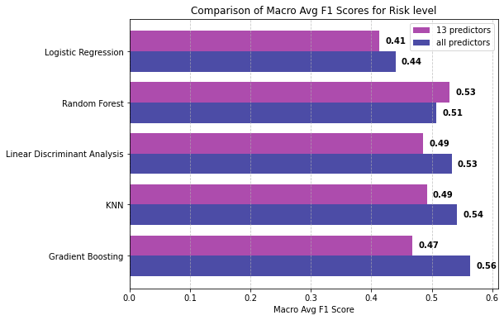
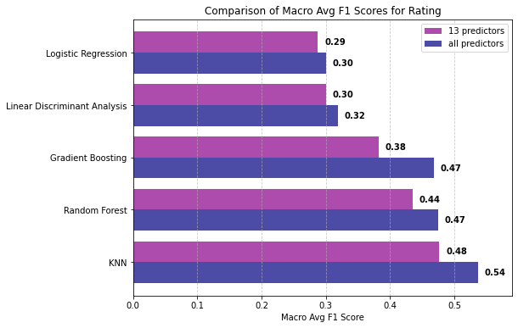
Feature Selection (ANOVA F TEST + multicollinearity)
Risk level Macro F1 difference:
GB (-0.09), KNN ( -0.05),
LDA (-0.04), LR (-0.03), RF (+0.02)
Rating Macro F1 difference:
GB (-0.09), KNN ( -0.06), RF (-0.03), LDA (-0.02), LR (-0.01)
Overall: Macro F1 score dropped significantly for all MLs
What if we can find a better set of predictors?

Slide 35
Feature Selection (Backward elimination)
Performed using Gradient Boosting and Risk level as classification category while optimizing for macro-averaged F1-score.
For each subset of features, the model is evaluated using 5-fold cross-validation (see Appendix 9 for explanation of CV and Backward Elimination)
Optimal subset from Backward elimination (11 predictors):
‘Sector’, 'currentRatio’, 'grossProfitMargin’, 'returnOnCapitalEmployed’, 'assetTurnover’, 'fixedAssetTurnover', 'debtEquityRatio', 'debtRatio’, 'enterpriseValueMultiple’, 'operatingCashFlowPerShare’, 'operatingCashFlowSalesRatio’

Slide 36
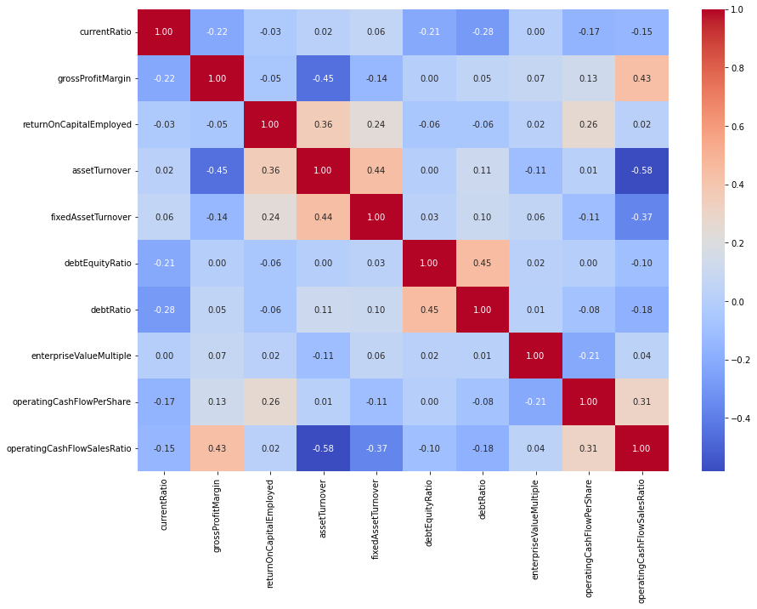
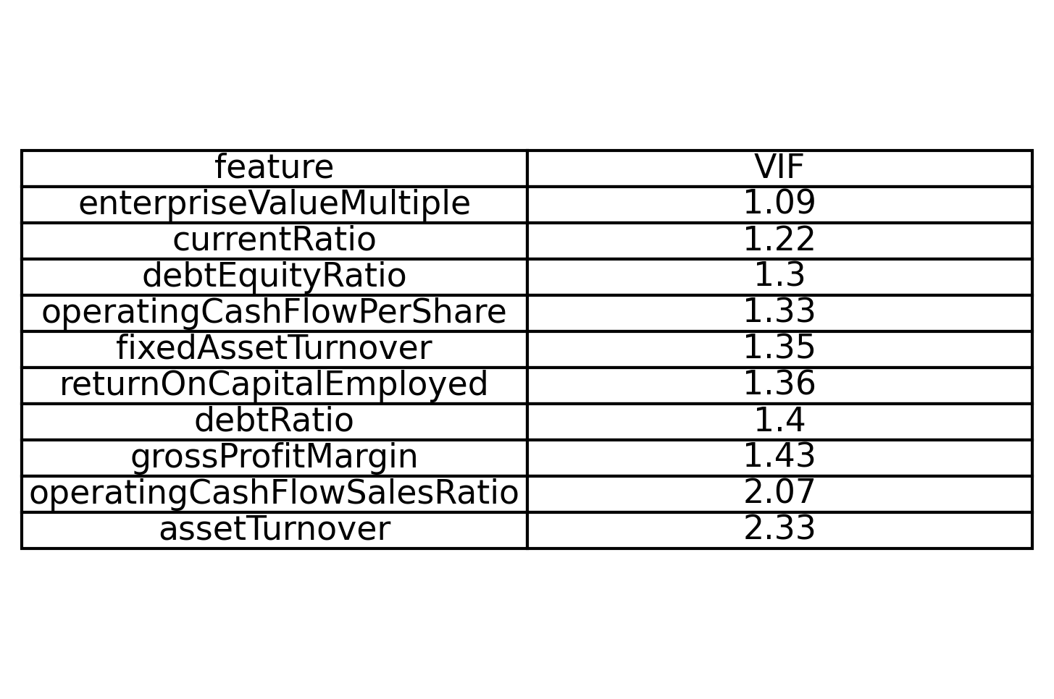
Feature Selection (Backward elimination)
VIF in [1,2]
Absolute value of Pearson correlation coefficient < 0.6 for all pairs of predictors

Slide 37
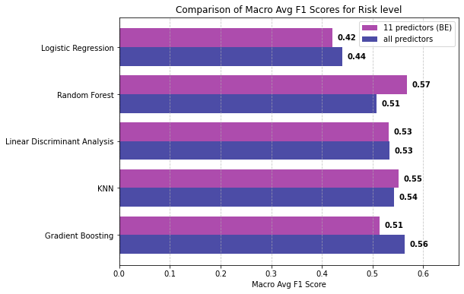
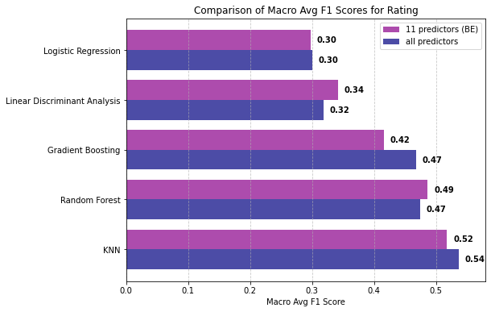
Feature Selection (Backward elimination)
Risk level Macro F1 difference:
GB (-0.05) , LR (-0.02), KNN ( +0.01), RF (+0.06)
Rating Macro F1 difference:
GB (-0.05), KNN ( -0.02), RF (+0.02), LDA (+0.02)
Overall: Macro F1 score dropped no more than 0.05. For some ML it even increased slightly.
Number of predictors reduced from 26 to 11.

Slide 38
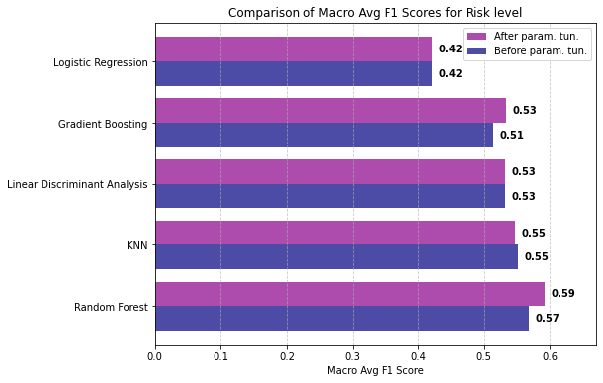
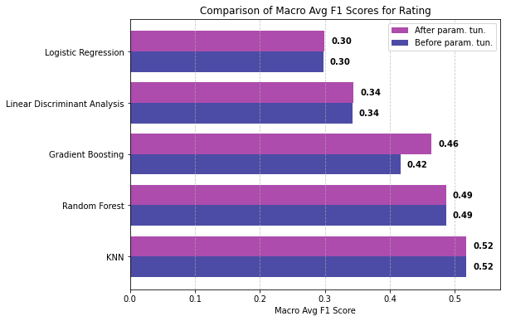
Parameter Tuning (performance of models)
Models were trained using all possible hyperparameters combinations and evaluated on Macro average F1 score using 5 fold cross validation. (Appendix 10-11 )
Best parameters for each model are in Appendix 12
Risk level Macro F1 difference:
RF (+0.02), GB (+0.02)
Rating Macro F1 difference:
GB (+0.04)
Overall: Macro F1 score significantly increased for ensemble ML models such as RF, GB.
What if we use the same predictors and hyperparameters for balanced dataset?

Slide 39
Oversampling
In Risk level, the minority class “Highest Risk” is only 3%.
In Credit Rating, the minority classes “AA” and “CCC” are only 5% and 3 %, respectively.
We apply an oversampling technique to have an equal number of observations in each class.

Slide 40

Oversampling (SMOTE)
Oversampling technique that is based on KNN algorithm
For each minority class instance, SMOTE finds its 5 nearest neighbors in feature space.
Technique Explanation:
Choose minority class point x_{i}
Find 5 nearest neighbors of x_{i} . Pick one random point out of 5 neighbors x_{n} .
Create new synthetic point $x_{new}= x_{i}+λ∗\left(x_{n}−x_{i}\right)$, where $λ$ is random picked number between 0 and 1.
SMOTE continues generating synthetic samples until the minority class is balanced with the majority classes.

Slide 41
Oversampling (SMOTE results)
After applying smote technique separately on Risk level and Credit Rating, the 2 balanced datasets were received.
Every class has the same number of observations as the majority class.

Slide 42


Oversampling (ML evaluation)
Trained and tested 5 models using oversampling datasets, 11 predictors and the same hyperparameters from Grid Search
Risk level Macro F1 difference:
LDA (-0.01), LR (+0.09), RF (+0.14), KNN (+0.22), GB (+0.22)
Rating Macro F1 difference:
LDA (+0.10), LR (+0.16), RF (+0.29), KNN (+0.29), GB (+0.30)
Overall: Macro F1 score significantly increased for all ML models.

Slide 43
Conclusion
The highest achieved F1 Score is 0.81 (KNN for balanced rating dataset).
The top 3 models after Parameter Tunning and Feature Selection are KNN, RF, GB for classifying Risk level and Credit Rating.
Reduced number of features from 26 to 11 using Backward elimination:
'Sector’, 'currentRatio’, 'grossProfitMargin’, 'returnOnCapitalEmployed’, 'assetTurnover’, 'fixedAssetTurnover', 'debtEquityRatio', 'debtRatio’, 'enterpriseValueMultiple’, 'operatingCashFlowPerShare’, 'operatingCashFlowSalesRatio’
Oversampling significantly improved Macro average F1 Score of models.

Slide 44
Importance
Investors decide to buy the corporate bonds based on company’s credit rating.
High credit rating → company with high probability will repay its debt
Low credit rating → company can struggle with paying back its debt
Lower credit rating → higher risk level, so investors expect higher interest rate of bonds to compensate for the risk of the investment
The credit rating is typically reviewed and restated quarterly based on financial statements by 3 main credit rating agencies (Moody’s, Standard & Poor’s, and Fitch). The process can be automated by implementing effective ML model based on financial indicators from financial statements to assign credit rating. Investors will be able to alter their investment strategies based on predicted credit rating.

Slide 45
FUTURE ENHANCEMENTS
Choose top 3 models and create an ensemble method by using Majority Voting/Stacking method.
Choose only specific time period (for example, Credit Rating and corresponding financial indicators from 2017-2024).
Choose only corporate companies which were rated consistently over the specific time period (for example, has annual credit rating).
Have the same number or nearly equal number of observations in each rating class.
Perform feature selection for each model separately using Accuracy as the evaluation metric as dataset is balanced.

Slide 46
Appendix 1: Machine Learning models (LR)
1. Logistic Regression (LR)
Mechanics:
Extends binary logistic regression using softmax regression (generalized logistic function) to compute probabilities for multiple classes.
Uses cross-entropy loss and optimization techniques (e.g., gradient descent).
Assigns a sample to the class with the highest probability.
Assumptions / Notes :
Linearity: The relationship between predictors and log-odds is linear.
Independence of features: No multicollinearity.
No extreme outliers: Since they can distort coefficient estimates.

Slide 47
Appendix 2: Machine Learning models (LDA)
2. Linear Discriminant Analysis (LDA)
Mechanics:
Computes the mean vector and covariance matrix for each class.
Projects data onto a new space that maximizes class separation using multiple discriminant axes.
Uses Bayes’ theorem to assign a new sample to the most probable class.
Assumptions / Notes:
Normal distribution: Features within each class follow a Gaussian distribution.
Equal covariance matrices: The variance structure is the same across all classes.
Independence: Features should not be highly correlated.

Slide 48
Appendix 3: Machine Learning models (KNN)
3. K-Nearest Neighbors (KNN)
Mechanics:
Stores all training data and makes predictions based on the majority vote of the k closest points (neighbors).
Uses distance metrics like Euclidean distance to measure similarity.
Assumptions / Notes :
Local structure matters: Nearby points should have the same class.
All features contribute equally: Requires proper feature scaling (e.g., Min-Max or Standardization).
Curse of dimensionality: High-dimensional data can make distance-based measures less meaningful.

Slide 49
Appendix 4: Machine Learning models (RF)
4. Random Forest (RF)
Mechanics:
Creates multiple decision trees using bootstrap sampling (random subsets of data) and random feature selection.
Aggregates predictions from all trees using majority voting (classification) or averaging (regression).
Reduces overfitting compared to single decision trees.
Assumptions/Notes:
Works well without strong assumptions about data distribution.
Trees should be deep enough to capture patterns but not too deep to avoid overfitting.
More trees generally improve stability but increase computation time.

Slide 50
Appendix 5: Machine Learning models (GB)
5. Gradient Boosting (GB)
Mechanics:
Builds decision trees sequentially, where each new tree is trained on the residual errors of the previous trees.
Uses a weighted sum of trees to make predictions.
Boosting reduces bias by adding models iteratively and adjusting their importance using gradient descent.
Regularization techniques (shrinkage, subsampling, tree depth limits) help prevent overfitting.
Assumptions / Notes:
No strict assumptions about feature distribution or linearity.
Sensitive to hyperparameter tuning (learning rate, number of trees, tree depth).
Can overfit if too many trees are added without regularization.

Slide 51

Appendix 6: Feature Selection (ANOVA F TEST + multicollinearity)
Correlation matrix for 16 predictors from ANOVA F Test
Severe Multicollinearity
preTaxProfitMargin &ebitPerRevenue – 0.98
ReturnOnAssets & ReturnOnCapitalEmployed – 0.89
preTaxProfitMargin & operatingProfitMargin – 0.9
preTaxProfitMargin&NetProfitMargin – 0.9

Slide 52

Appendix 7: Feature Selection (ANOVA F TEST + multicollinearity)
VIF for 16 predictors from ANOVA F Test.
Severe Multicollinearity
preTaxProfitMargin and ebitPerRevenue (VIF = 37.1)
- severe multicollinearity (VIF>16)

Slide 53


Appendix 8: Multicollinearity (ANOVA F Test optimal subset)
Fig1: VIF for optimal subset of predictors from ANOVA F Test
Fig2: Correlation matrix for optimal subset of predictors
from ANOVA F Test

Slide 54

Appendix 9: Backward Elimination
It starts with all features (26 predictors) and removes the least important ones until macro-averaged F1 – score stops improving.
For each subset of features, the model is evaluated using 5-fold cross-validation.
Cross-validation (CV) is a technique used to evaluate the performance of a model by splitting the dataset into multiple parts (folds) and testing it on different subsets.
In 5-fold cross-validation, the dataset is divided into 5 equal parts (folds).
The model is trained on 4 folds and tested on the remaining fold.
This process repeats 5 times, with each fold used as the test set once.
The final model performance is averaged over all 5 iterations to reduce randomness.
Cross validation

Slide 55
Appendix 10: Parameter Tuning
Gradient Boosting: “n_estimators": [100, 200,300, 400, 500], "learning_rate": [0.01, 0.05, 0.1, 0.2, 0.3], "max_depth": [3, 4, 5, 6, 7, 8, 9]
Random Forest: “n_estimators”: [100, 200, 300], max_depth": [None, 10, 20], "min_samples_split": [2,5,10]
Linear Discriminant Analysis: "solver": ["svd", "lsqr"]
Logistic Regression: C: [0.1, 1, 10]
KNN: "n_neighbors": 1-20

Slide 56
Appendix 11: Parameter Tuning (Definition)
Gradient Boosting
n_estimators: The number of boosting stages (trees). More trees can improve accuracy but increase training time.
learning_rate: Controls how much each tree contributes to the final model. A lower value requires more trees to achieve good performance.
max_depth: The maximum depth of each tree. Deeper trees capture more patterns but may lead to overfitting.
Random Forest
n_estimators: The number of trees in the forest. More trees improve stability but increase computation time.
max_depth: The maximum depth of the trees. If None, nodes expand until all leaves are pure or contain fewer than min_samples_split samples.
min_samples_split: The minimum number of samples required to split an internal node. Higher values prevent overfitting.
Linear Discriminant Analysis (LDA)
solver: The algorithm used to compute the LDA transformation.
"svd": Does not compute the covariance matrix (useful for large datasets).
"lsqr": Uses least squares estimation, suitable for well-conditioned problems.
Logistic Regression
C: Inverse of regularization strength. Smaller values add stronger regularization (preventing overfitting), while larger values allow more flexibility.
K-Nearest Neighbors (KNN)
n_neighbors: The number of nearest neighbors used for classification. Smaller values increase sensitivity to local variations, while larger values provide smoother decision boundaries.

Slide 57
Appendix 12: Parameter Tuning (Best Parameters)
Table 1: Best hyperparameters for risk level ML models
Model | Best Hyperparameters
Gradient Boosting | "n_estimators": 300, 'learning_rate': 0.1, "max_depth": 7
Random Forest | n_estimators": 100, "max_depth": 20, 'min_samples_split': 5
Linear Discriminant Analysis | "solver": "svd"
Logistic Regression | 'C': 10
K-Nearest Neighbors | "n_neighbors": 1
Model | Best Hyperparameters
Gradient Boosting | "n_estimators": 100, 'learning_rate': 0.1, "max_depth": 7
Random Forest | n_estimators": 200, "max_depth": None, 'min_samples_split': 2
Linear Discriminant Analysis | "solver": "lsqr"
Logistic Regression | 'C': 10
K-Nearest Neighbors | "n_neighbors": 1
Table 1: Best hyperparameters for risk level ML models
Table 2: Best hyperparameters for rating ML models

Slide 58
Sources
1. https://www.kaggle.com/datasets/agewerc/corporate-credit-rating/data
2. https://www.investopedia.com/terms/c/creditrating.asp
3. https://www.investopedia.com/terms/c/corporate-credit-rating.asp
4. https://www.investopedia.com/ask/answers/102814/how-long-are-credit-ratings-valid.asp
5. https://www.researchgate.net/publication/331386740_Credit_Rating_Forecasting_Using_Machine_Learning_Techniques

